Slide 1
Controlling the Drone with the keyboard

Slide 2
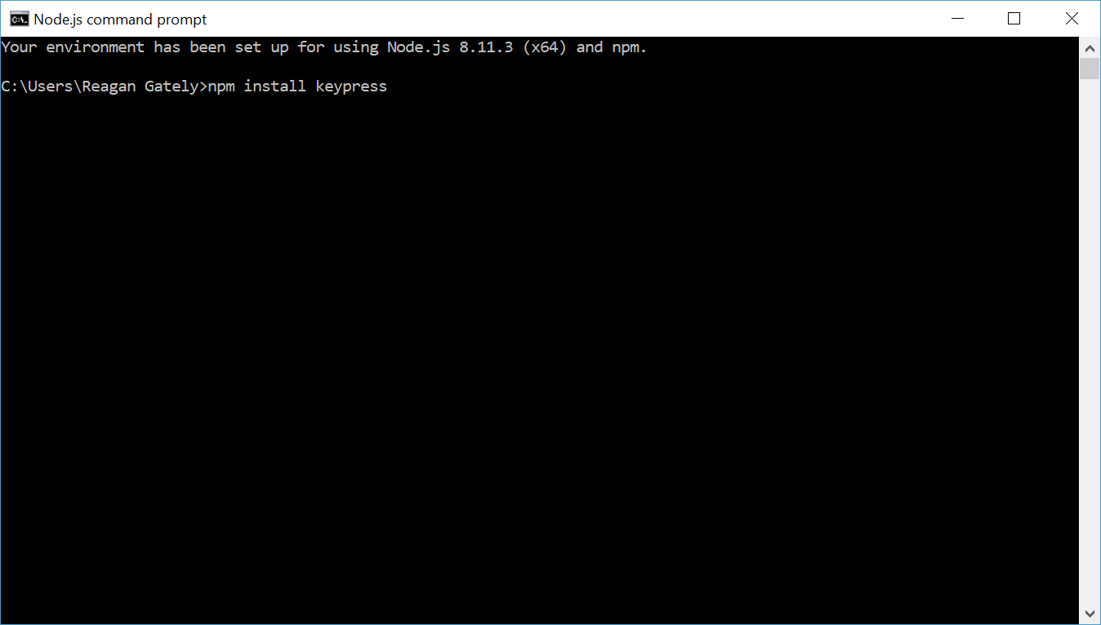
Installing the keyboard module
Open nodeJs command prompt and type the following

Slide 3
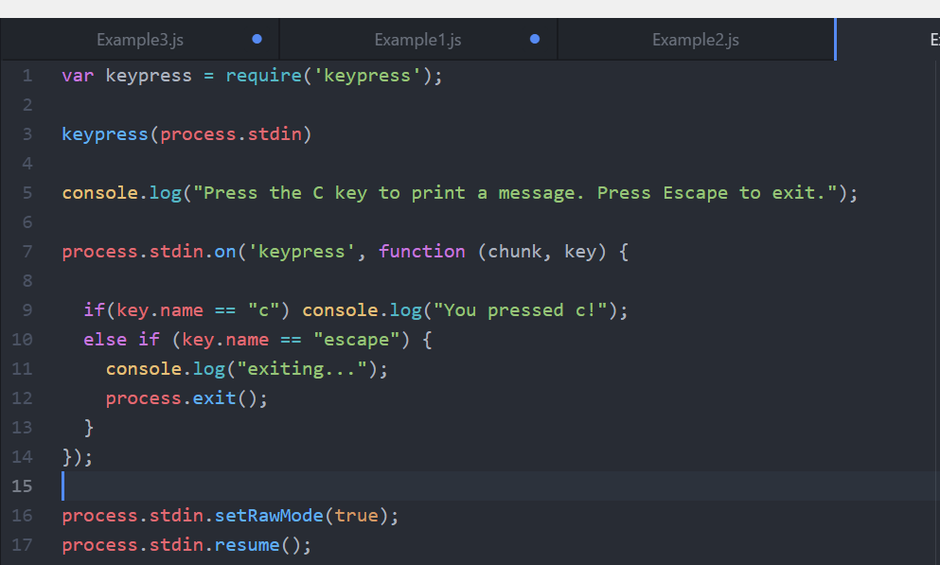
Keypress module example program

Slide 4
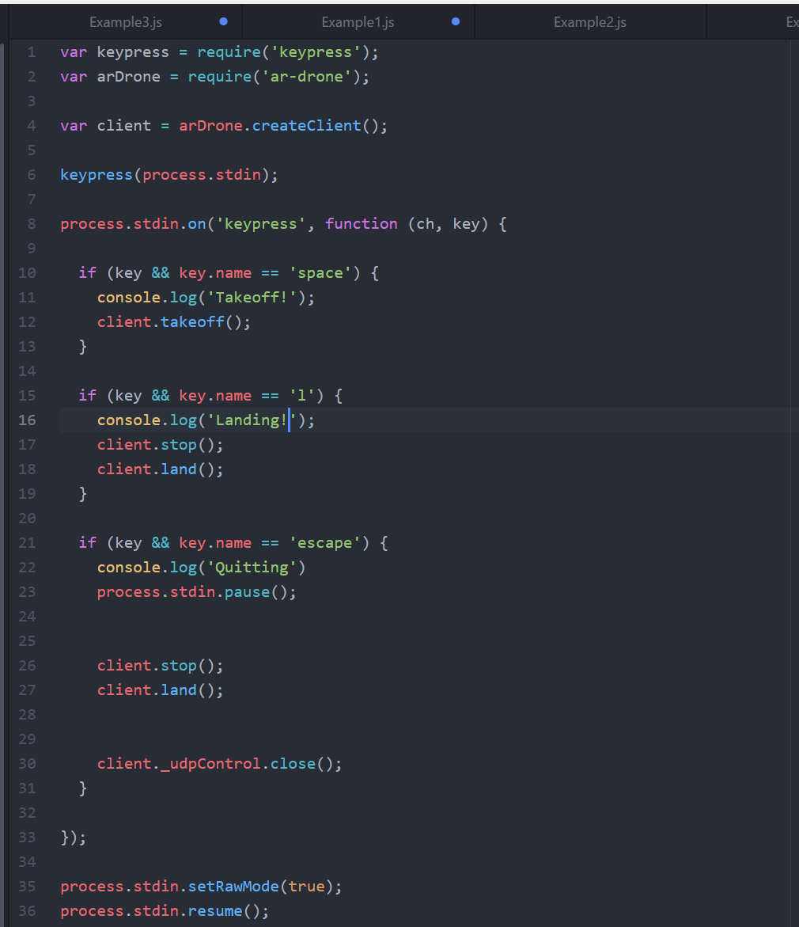
Using the Keypress module to control takeoff/landing

Slide 5
Running the program
Run the program using the NodeJs command prompt and you should be able to make the drone takeoff and land using the spacebar and the L key. You can use the Escape key to exit the program.

Slide 6
Challenge: Add more actions to the program
In addition to takeoff and landing, we would to be able to control the direction of the drone. Try writing some code to control the direction of the drone using the w, a, s, and d keys.

